Slide 1
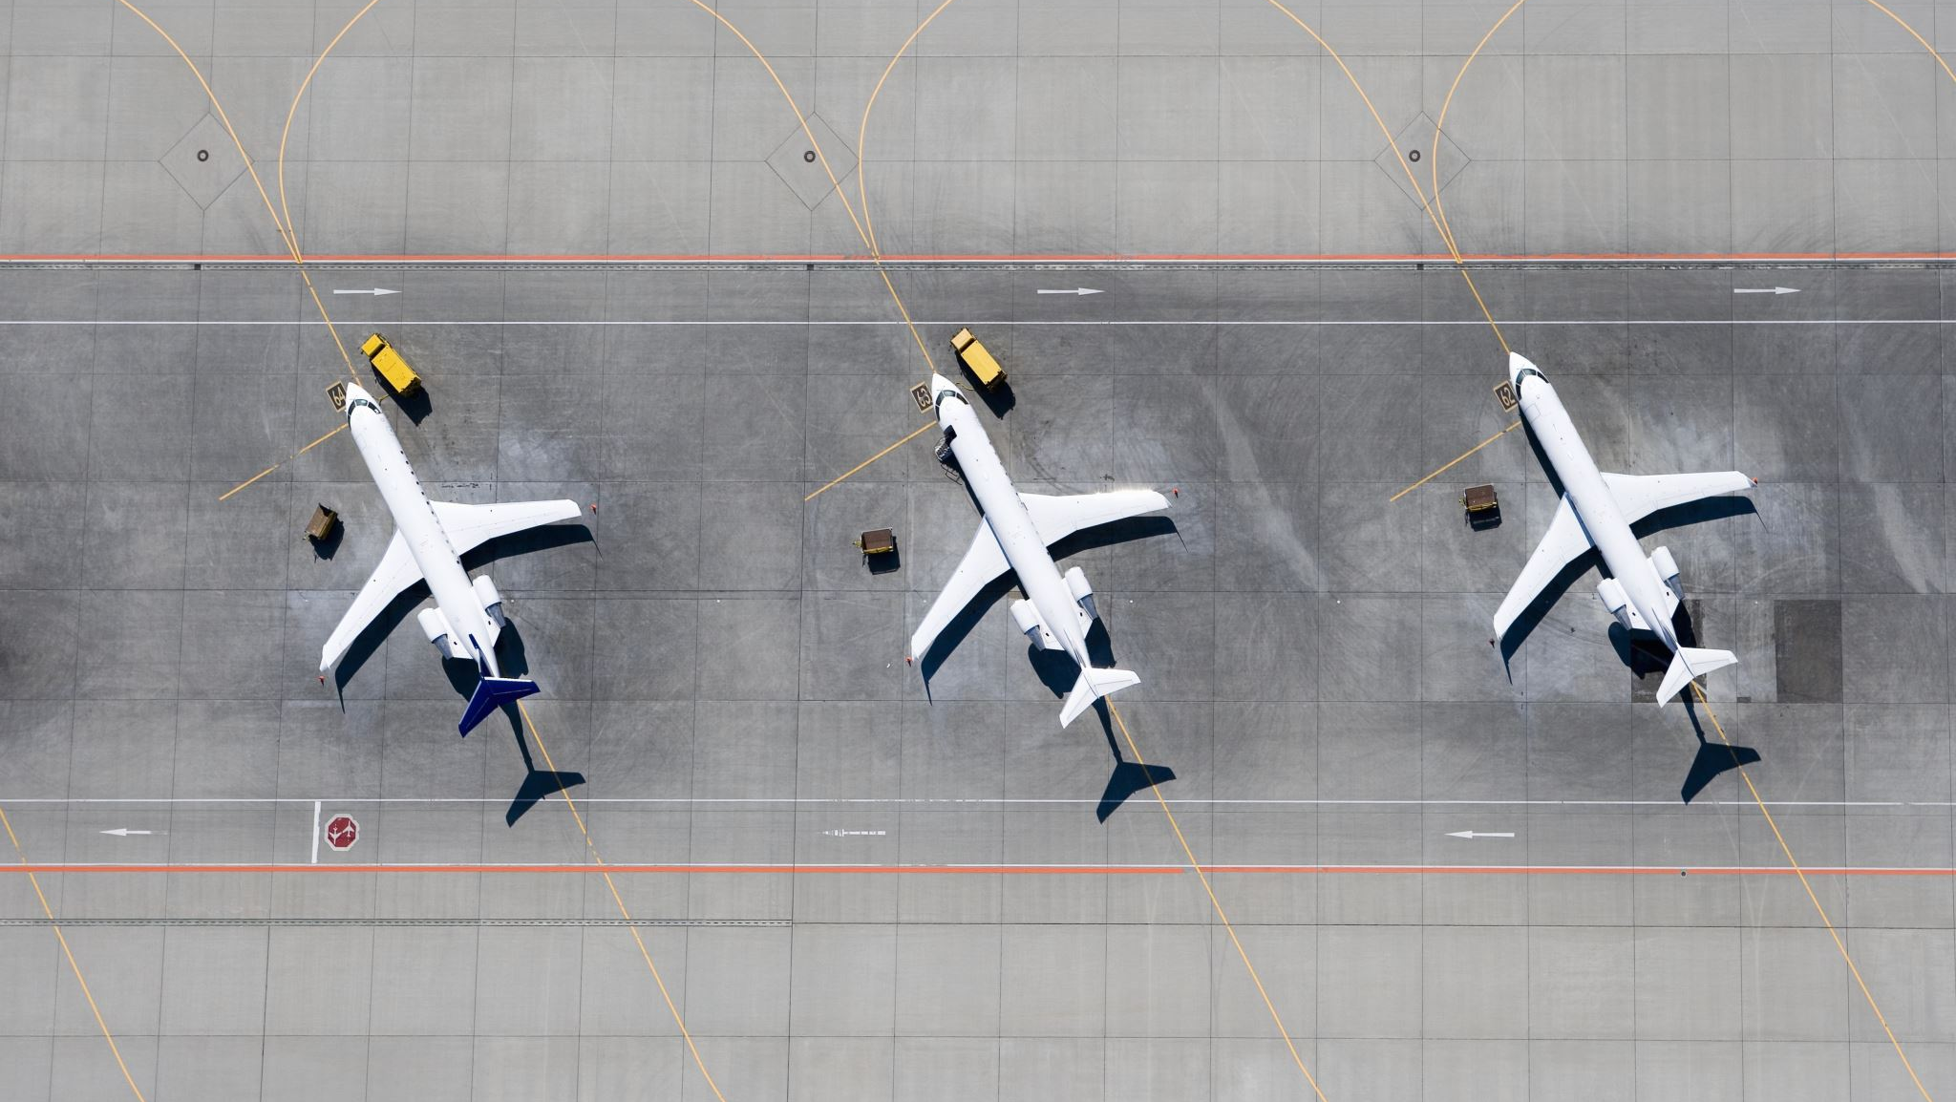
Predicting flight cancellations in advance with machine learning models

Slide 2
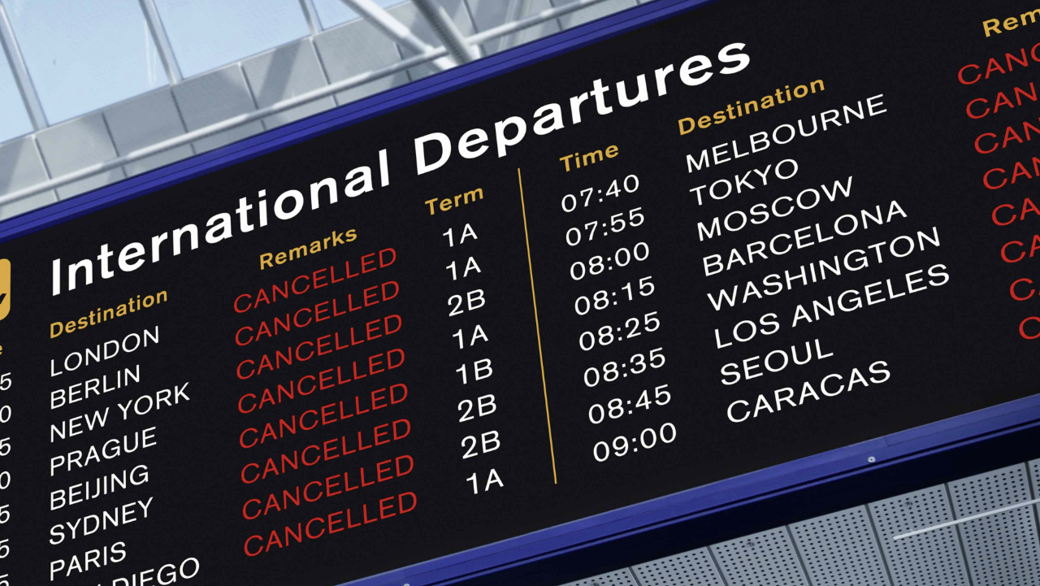
Flight cancellations does not only waste the time of travelers it may also make them lose money due to missed cruises, prepaid hotel rooms, increased parking fees, cancellation or postponement of business trips and additional cost of unplanned air tickets.

Slide 3

Problem Statement
What tool can be used by air travelers to predict flight cancellations in advance?

Slide 4

Solution
Building a model that predicts flight cancellations will serve as an important tool used by air travelers to predict flight cancellations in advance

Slide 5

Data Sources
1.The 2015 Flight Delays and Cancellations (kaggle.com) downloaded from Kaggle. It has about three files airlines.csv, airports.csv and flights.csv
2.airlinedelaycauses_DelayedFlights.csv also downloaded from Kaggle
3.The supplementary dataset was downloaded from Open data @ OurAirports
3. Supplementary dataset was downloaded from Open data @ OurAirports

Slide 6
Data Wrangling
Renaming datasets
Handling missing values
Handling abbreviated values
Handling duplicate columns
Merging
Resulting dataset
fl_delay
7755837 rows
42 columns

Slide 7
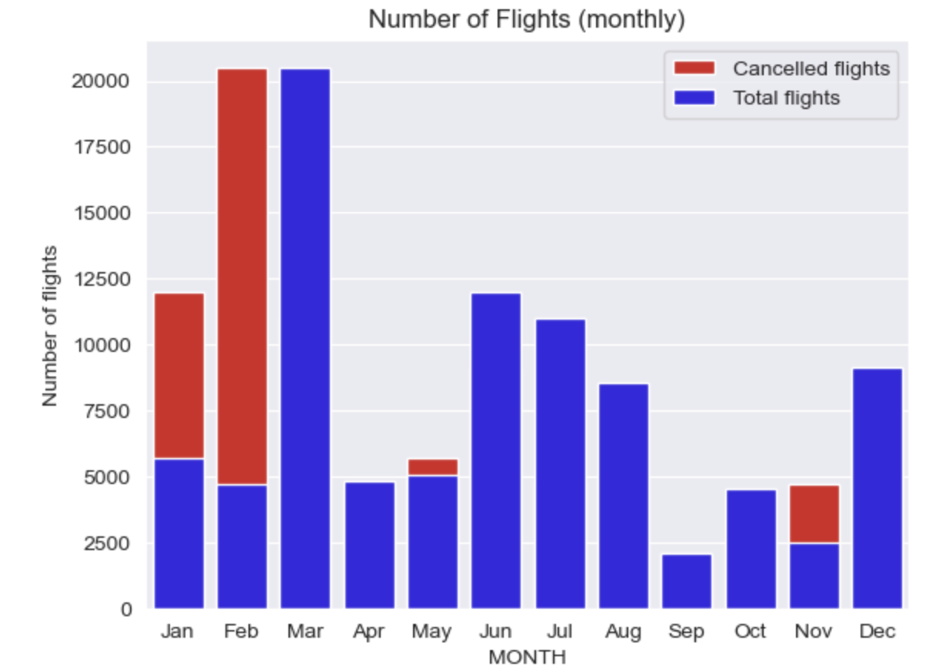
Exploratory Data Analysis
More flights were cancelled in November, January and February.
This may be due to harsh winter weather conditions.

Slide 8
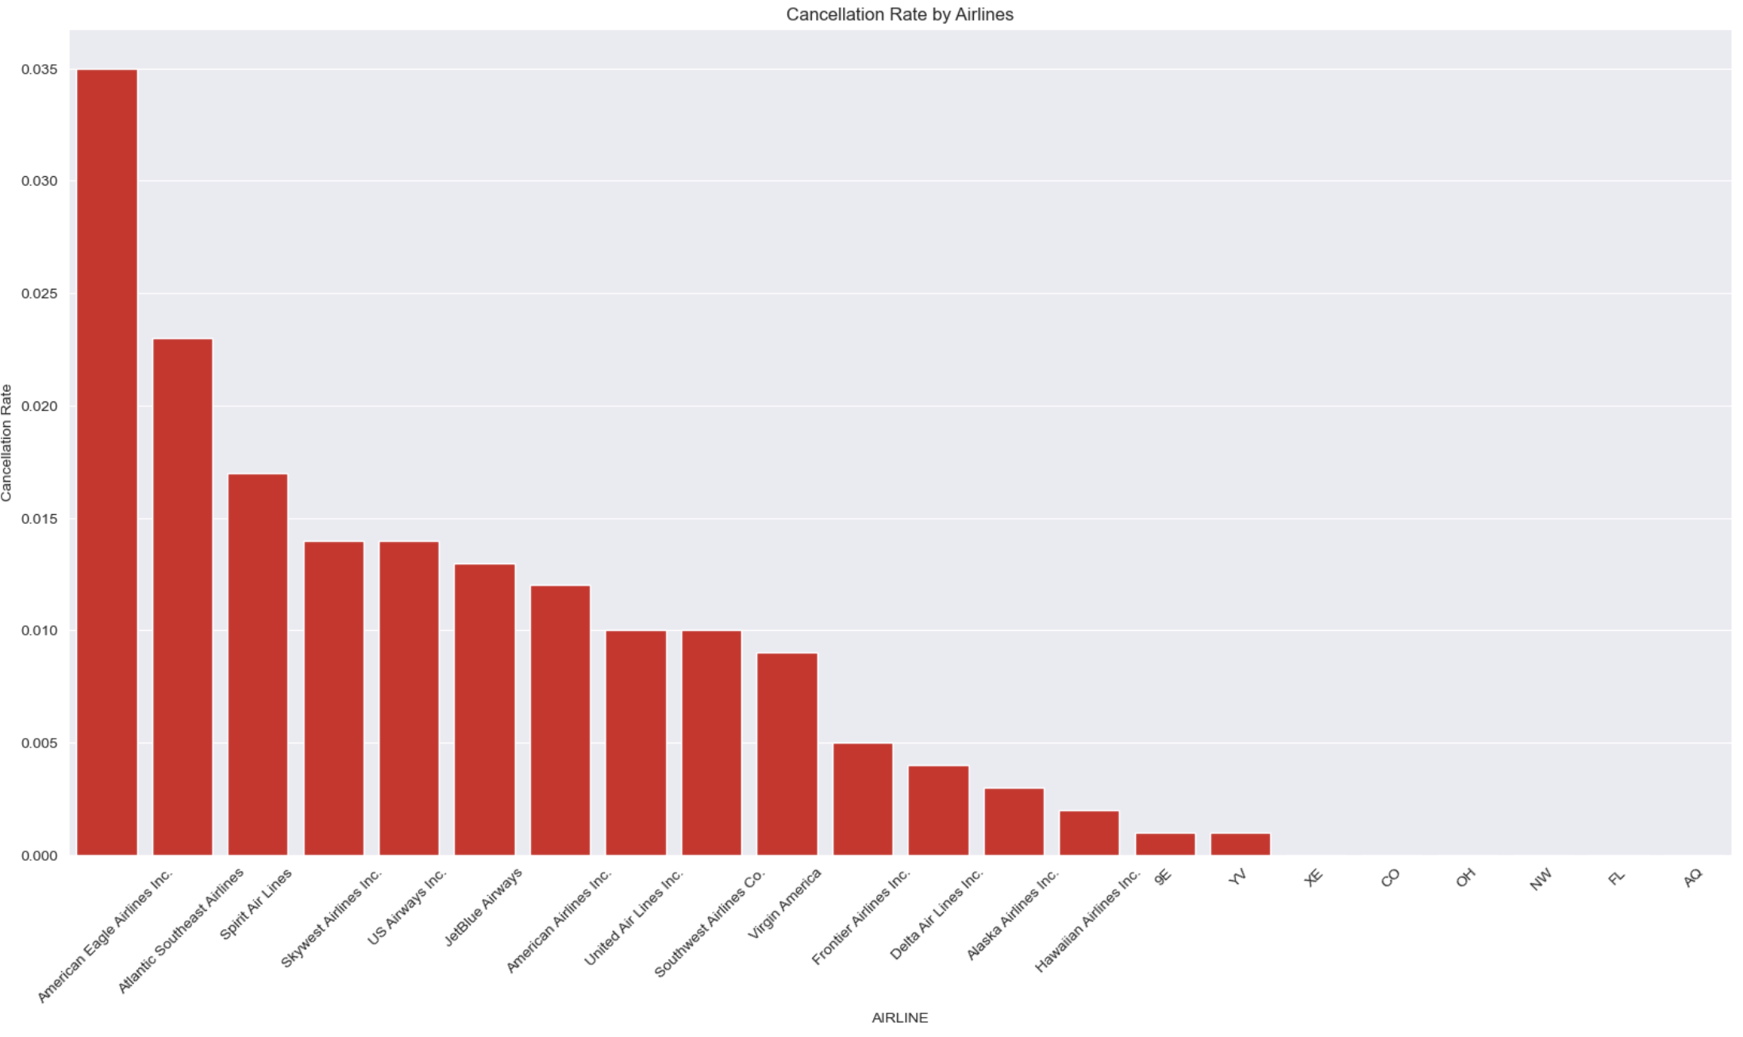
American Eagle Airlines Inc was responsible for the most flight cancellations at a cancellation rate of 3.5%.

Slide 9
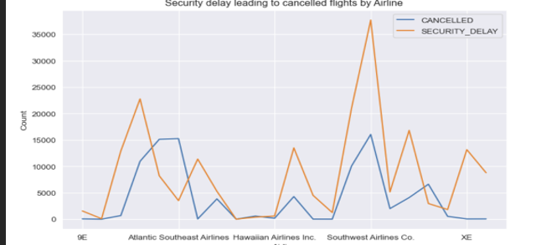
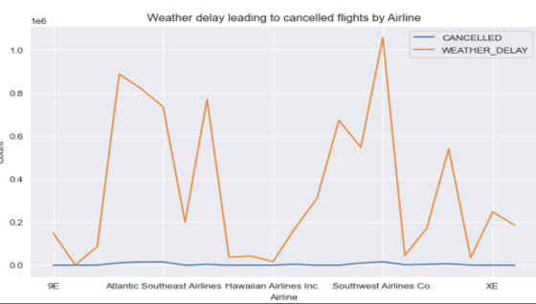
Security and Weather delays were most likely to cause flight cancellations.

Slide 10
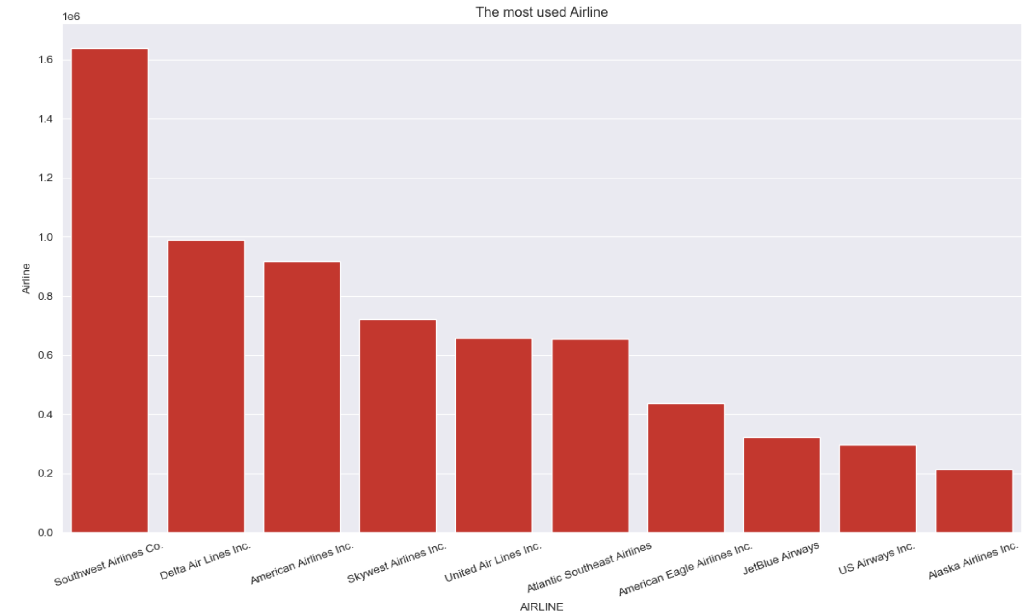
Southwest Airlines Co. has the most patronized flights

Slide 11
Preprocessing
delay features were dropped
id, ident, Cancellation reason, type, name, tail number, latitude_deg, longitude_deg, elevation_ft, iso_country, iata_code were dropped
Categorical columns like Origin and Destination airports were dropped
Airline and IATA code were encoded
X and y variables were defined
(dependent variable ‘CANCELLED’)
Data was split into training and test sets in the ratio 80:20 respectively

Slide 12
Modelling
Two machine learning models were built to predict flight cancellation.
Decision Tree Regressor with the max depth parameter set to 2.
Random Forest Classifier Model. The n_estimators parameter was set to 8.

Slide 13
Model Evaluation
Model Assessment | Decision Tree Classifier | Random Forest Model
accuracy | 1.0 | 1.0
F1 score | 1.0 | 1.0
AUC | 0.99 | 1.0

Slide 14
Model Evaluation- Confusion matrix
Comparing confusion matrices of both models showed that,
Random Forest Model was able to identify more true negatives than decision tree model. This resulted in lower false negative value identification.
Model | True Positive | True Negative | False Positive | False Negative
Decision Tree | 1533029 | 17953 | 0 | 186
Random Forest | 1533029 | 18125 | 0 | 14

Slide 15
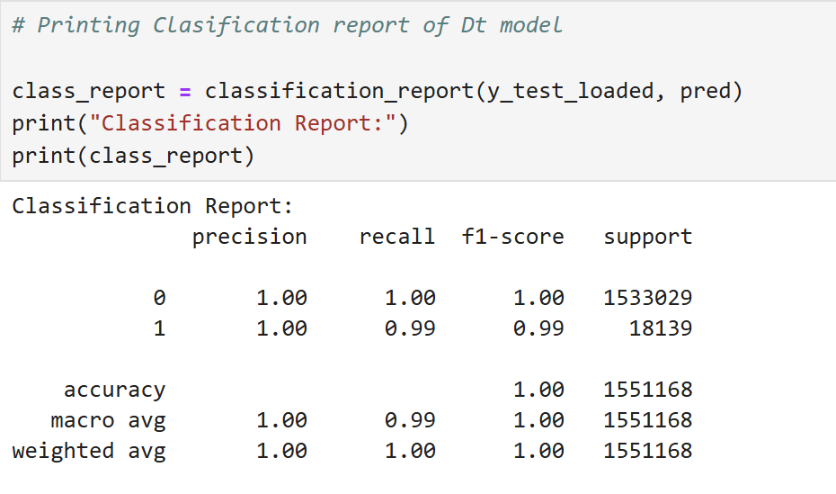
Model Evaluation- Classification Reports
Classification Report of Decision Tree Classifier model showed,
Class imbalance
The precision and recall scores of non dominant class was less than the scores for the dominant class.

Slide 16
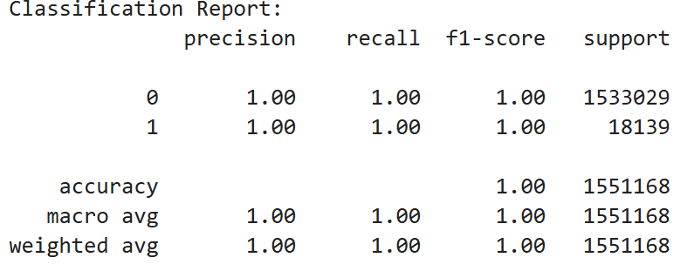
Random Forest Model
The classification report of the Random Forest model also showed that there is class imbalance.
One class was 1533029 and the other class was 18139.
For this reason, the accuracy of the model was not as relevant as the precision and recall of the model.
The final performance of the model showed both precision and recall scores to be 1.0.

Slide 17
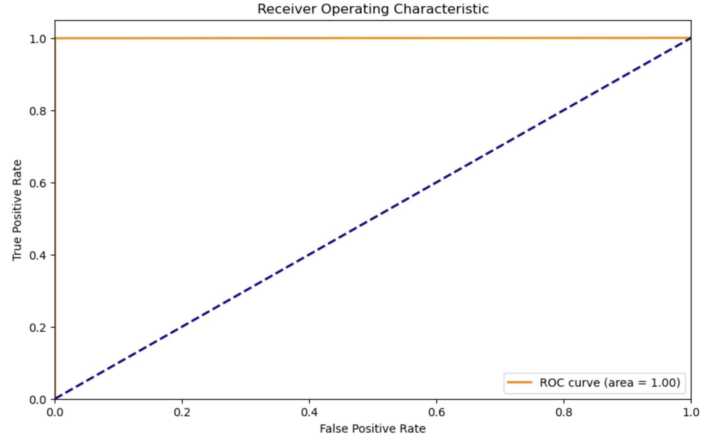
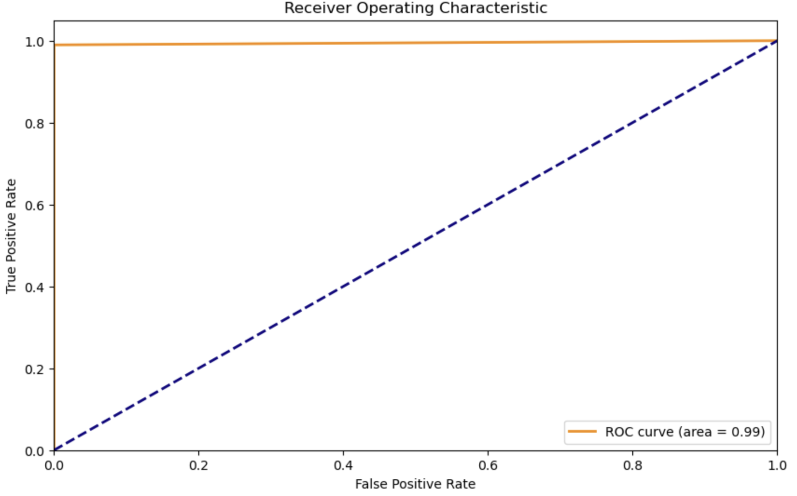
Model Evaluation ROC curve
Random Forest ROC
The graph proves that the diagnostic ability of both models is good.
The area under the curve value is 1.0 for RF and 0.99 for Decision Tree.
It shows that the RF model can rank a randomly positive instance higher than a randomly negative instance than the Decision tree model
Decision Tree ROC

Slide 18

Model Selection
The best model is the Random Forest Model

Slide 19
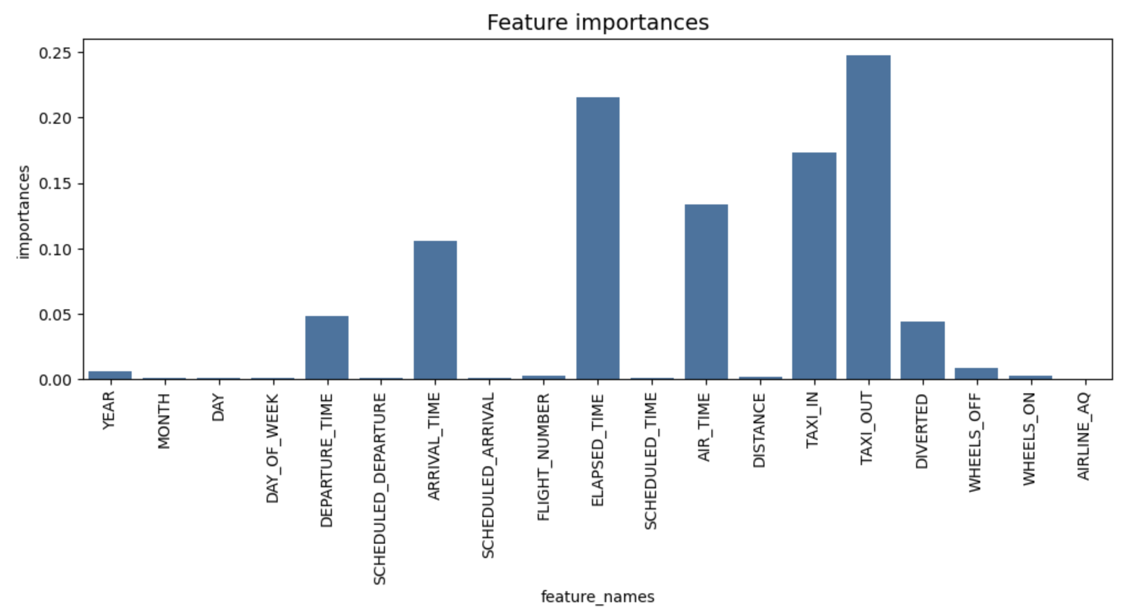
Random Forest Model
The most important features of the RF model are the taxi out, elapsed time and taxi in features.

Slide 20

MODEL LIMITATION
Model was unable to differentiate 14 training data accurately.
Model found 14 false negatives.
False negatives mean that model will wrongly predict flight cancellations in these
This defeats the objective of this project

Slide 21
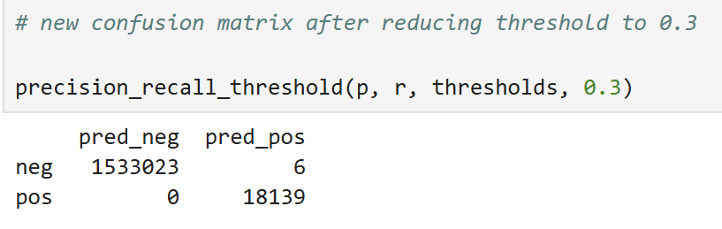
MODEL IMPROVEMENT
Model threshold line must be reduced to allow more false positives than false negatives
The effects of false positives will not lead to worse outcomes than false negatives
Threshold line reduced to 0.3.
This caused False negatives to reduce to 0 and false positive to increase to 6

Slide 22

Conclusion
Random Forest Model is the best predictive model for flight cancellations.
The most important feature for this model area taxi out, elapsed time and taxi in values
Reducing threshold line to from default 0.5 to 0.3 improved model by reducing false negatives from 14 to 0.

